Slide 1

Are there sustainable protein sources for non-ruminant livestock?
Ilias Kyriazakis and Ilkka Leinonen
School of Agriculture, Food & Rural Development Newcastle University, England

Slide 2
Presentation context
There are increased concerns about the reliance of EU livestock systems on imported soya
This is on both food security and environmental sustainability grounds
In addition there is scarcity of supply of non-GM soya bean meal
The question is: are there sustainable EU-grown protein sources that could replace soya?

Slide 3


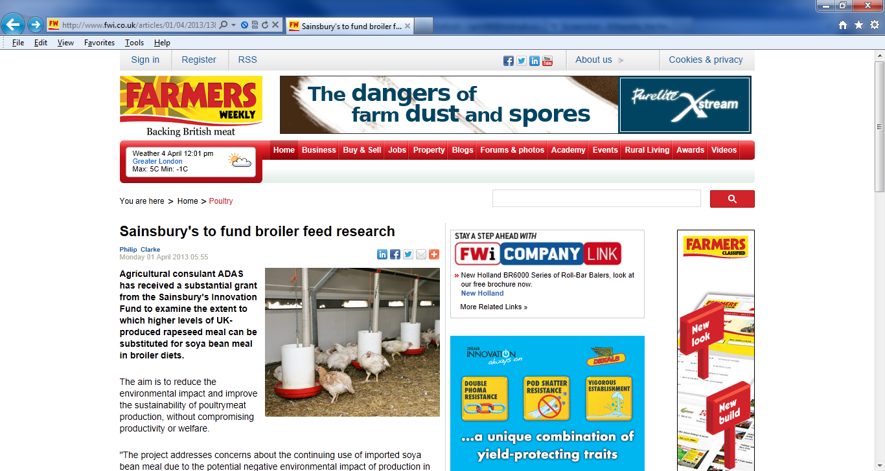
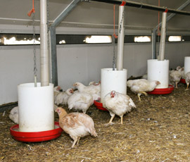
Image from: http://www.fwi.co.uk/articles/01/04/2013/138391/sainsbury39s-to-fund-broiler-feed-research.htm

Slide 4
Alterative protein sources:
Some criteria to assess sustainability
The alternative protein source must fulfil (at least) the following criteria:
  Maintenance of animal health, welfare and productivity
  Maintenance - if not reduction - of a system’s environmental impact
  Cost-effectiveness
  (Social acceptability)

Slide 5
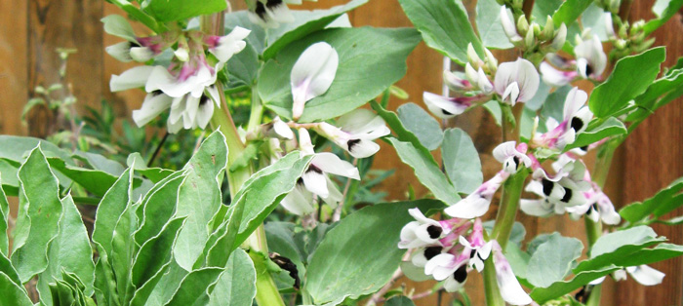


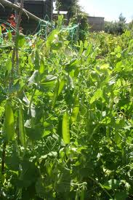
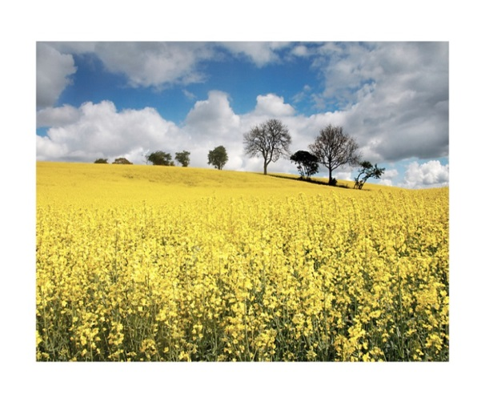
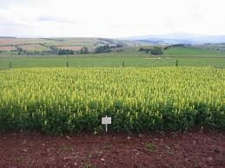
Some ‘potentially sustainable’ EU-grown protein sources

Slide 6
Performance of grower pigs on pulse-based diets
Diet | LW Gain (g/d) | Intake (g/d) | Gain: Intake | KO %
Soyabean meal (14%) | 823 | 1857 | 0.443 | 78.0
Faba beans ¹ (30%) | 907 | 2013 | 0.451 | 75.9
Peas ² (30%) | 834 | 1922 | 0.433 | 77.3
s.e.m. | 41 | 81 | 0.009 | 1.5
¹ var Prophet ² var Fuego
(Smith et al, 2013)

Slide 7
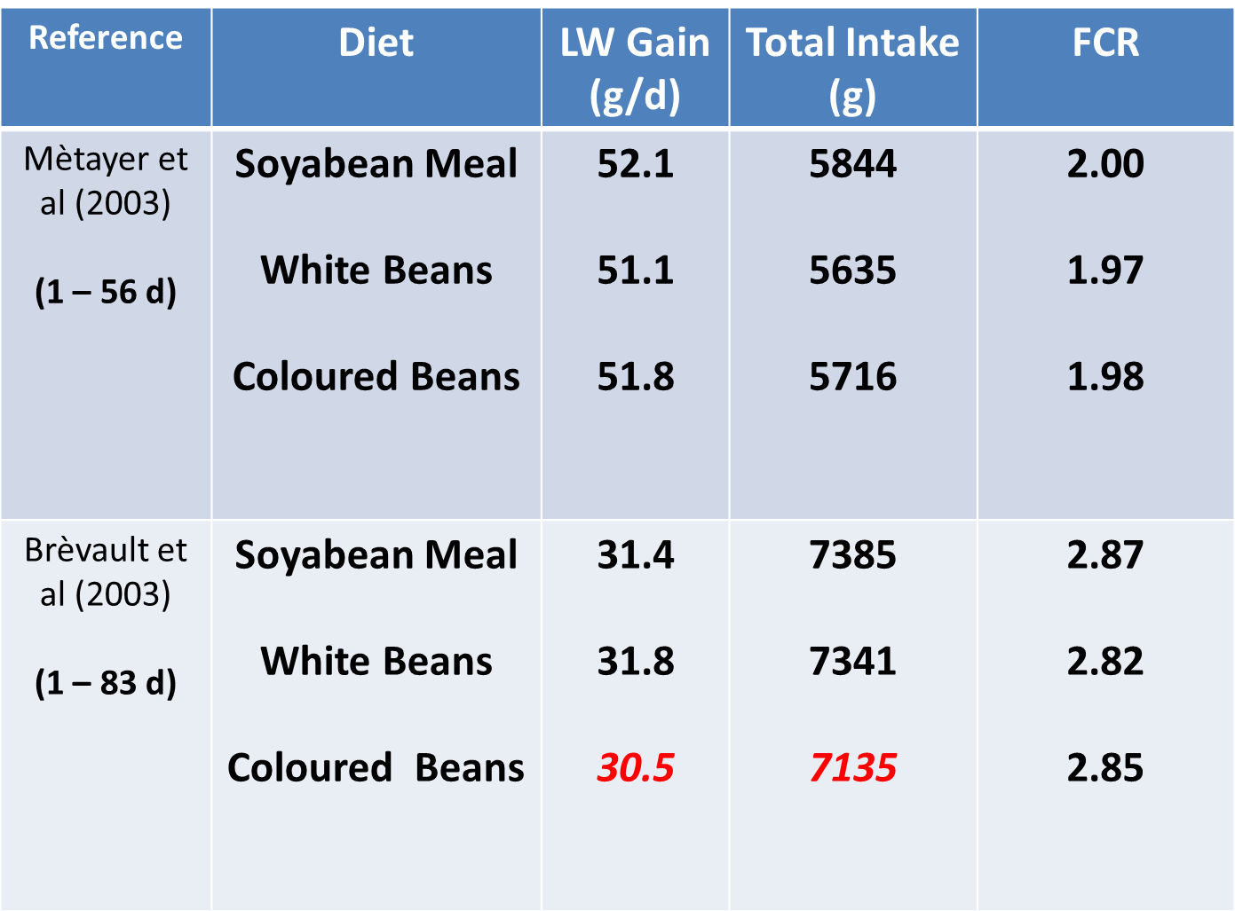
Performance of broilers on field bean-based diets (25% inclusion)

Slide 8
Interim Conclusions
A number of EU-grown protein sources can be included in the diets of pigs and poultry at high levels, without any detriment to their health and performance.
In some instances (e.g. pigs) their level of inclusion can obliterate entirely the need to include any soya bean meal in diets.
What are the environmental impact consequences of using home-gown protein sources?

Slide 9
LCA: a tool to estimate the environmental impact of commodities
Boundary at farm gate

Slide 10
Categories and main sources of environmental impacts
Primary energy use
  diesel (e.g. feed production and transport)
  electricity (e.g. ventilation)
  gas (e.g. heating)
Global warming potential (GWP₁₀₀)
  CO₂ from fossil fuel (crop production, transport, animal housing)
  Nitrous Oxide (and Methane) from animal housing and crop production
  CO₂ from land use changes
Eutrophication potential
Acidification potential

Slide 11
Categories and main sources of environmental impacts
Primary energy use
  diesel (e.g. feed production and transport)
  electricity (e.g. ventilation)
  gas (e.g. heating)
Global warming potential (GWP₁₀₀)
  CO₂ from fossil fuel (crop production, transport, animal housing)
  Nitrous Oxide (and Methane) from animal housing and crop production
  CO₂ from land use changes (loss of soil and C biomass)
Eutrophication potential
Acidification potential

Slide 12
Global Warming Potential (per 1000 kg of edible broiler carcass), kg CO₂ equivalent

Slide 13
Methods to account for land use changes – soya as an example
All soya used in broiler diets comes from mature agricultural land (sustainable)
All soya used in broiler diets comes from newly established agricultural land (worst case)
The soya used in broiler diets comes from a mixture of mature and newly established agricultural land (“best estimate”, PAS 2050)
All crops used in broiler diets have indirect land use change effects (top-down)

Slide 14
Methods to account for land use changes – soya as an example
All soya used in broiler diets comes from mature agricultural land (sustainable)
All soya used in broiler diets comes from newly established agricultural land (worst case)
The soya used in broiler diets comes from a mixture of mature and newly established agricultural land (“best estimate”, PAS 2050)
All crops used in broiler diets have indirect land use change effects (top-down)

Slide 15



Why do we need to account for Land Use changes? A paradox
Organic soya
Conventional soya

Slide 16
Some ‘potentially sustainable’ EU-grown protein sources

Slide 17
Total amount of ingredients consumed over the growing period (kg per broiler)

Slide 18
The Global Warming Potential of soya and field bean-based diets fed to broilers

Slide 19
Total amount of ingredients consumed over the growing period (kg per broiler)

Slide 20
The Global Warming Potential of soya and pea-based diets fed to broilers

Slide 21
The Global Warming Potential of pig diets based on EU-grown feedstuffs
Meul et al, 2012

Slide 22
Why aren’t home grown protein sources more effective?
There are GWP reductions due to reduced transport emissions and emissions from land use changes.
These reductions are relatively small
In addition the removal of soya requires the addition of pure amino acids and vegetable oil; the GWP of these ingredients per unit of ingredient is relatively high

Slide 23
Interim Conclusions
Home-grown protein crops maybe able to replace soya beans in non ruminant diets
Whether there are reductions in greenhouse gas emissions as a result of this substitution will depend on the LUC accounting method
Even when direct land use changes related to soya production are included, the reduction of GWP does not exceed 15%

Slide 24
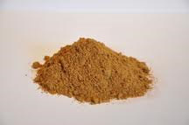
Can Processed Animal Protein (PAP) be a sustainable protein source?
Currently, inclusion of PAP in animal diets is not allowed in the EU; the situation may change
In the UK ~ 85k tn of Category 3 PAP is produced annually. In theory ~ 20k tn of this is porcine PAP and can be fed to chickens
Currently all UK PAP produced is fed to pets
What are the environmental consequences of feeding porcine PAP to chickens at either 5 or 10% inclusion levels?

Slide 25
Global Warming Potential of broiler feed with different inclusion rates of PAP

Slide 26
A more realistic estimation of the consequences of PAP feeding to livestock
In the EU ca 2.3m tn of PAP are produced annually; ~ 60% of this is used for pet food and 40% as fertiliser
The amount of PAP currently used as fertiliser can in theory be fed to livestock
This can reduce the environmental impact of EU non-ruminant livestock systems after the current ‘credits’ from using PAP as fertiliser are accounted for
These estimated are currently work in progress

Slide 27

Is there a trade-off between diet cost and its environmental impact?
Diet Cost
Environmental Impact

Slide 28
Costs of feed and environmental impact (GWP) per tonne of broiler meat
 | Least Cost Formulation |  | Least GWP Formulation
 | Jan 2012 | Sept 2012
£ Jan 12 | 564 | N/A | 593
£ Aug 12 | N/A | 732 | 742
GWP (kg CO₂ eq) | 2810 | 2780 | 2706

Slide 29
The relationship between feed cost and GWP of broiler feeds

Slide 30
Some food for thought – in place of conclusions
There are EU-grown protein sources that seem to meet the criteria of ‘sustainability’
The environmental impact consequences of using them are not dramatic, because all consequences of their use need to be taken into account
For the same reason the consequences of using PAP (and other co-products) would not be as spectacular as previously suggested
There are trade-offs between least cost formulation and environmental impact; the question is would anyone be willing to pay for the latter?

Slide 31
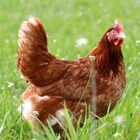
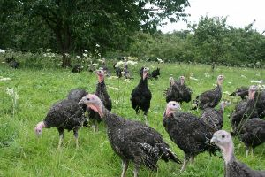
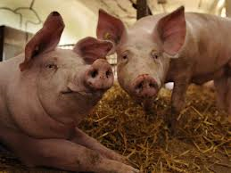
Thank you !!!

Slide 32
Categories and main sources of environmental impacts (2)
Eutrophication potential
  Nitrate (NO₃) leaching to water
  Phosphate (PO₄) leaching to water
  Ammonia (NH₃) emissions to air
Acidification potential
  Ammonia (NH₃) emissions to air
  Sulphur dioxide (SO₂) from fossil fuels

