Slide 1

Thermal Taster Status
Investigating Preference for Carbonated Soft Drinks across Thermal Taste Phenotype
Isobel Payne
Undergraduate Food Science Student

Slide 2
Outline
Introduction to Thermal Taster Status
Research Project:
  Aim
  Method
  Results
  Conclusions

Slide 3
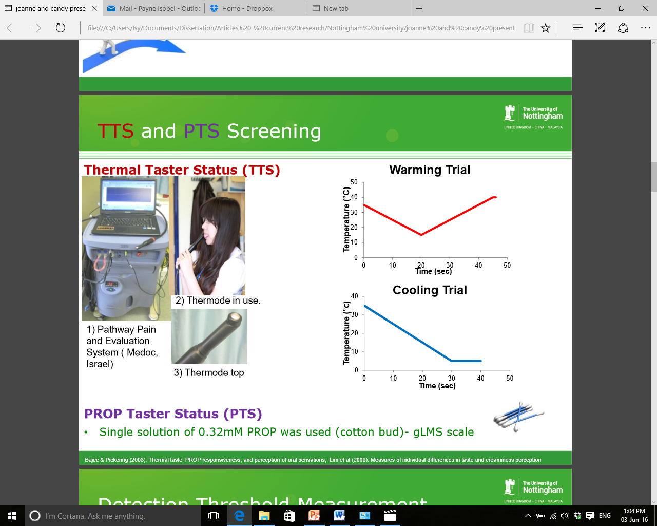
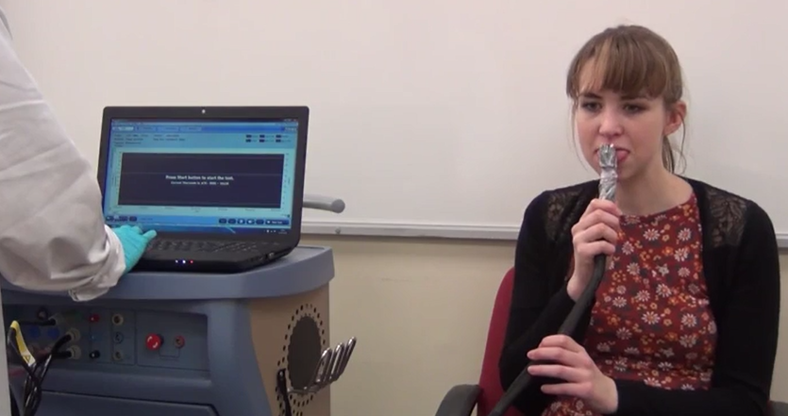
Phenotype:
Thermal Taster Status (TTS)
Phantom oral sensations shown in Thermal Tasters (TTs) due to temperature stimulation of the tongue
Warming trials: sweet is the most common
Cooling Trials: bitter, sweet and sour are most common
Current research shows differences in tasting abilities across two phenotypes :
  Increased intensity perception of oral stimuli
  Limited studies on taste preference and acceptability

Slide 4
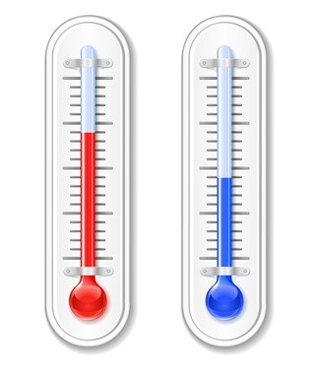
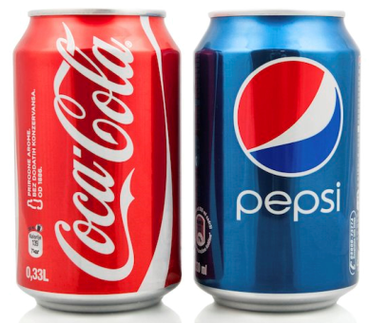
Aim of Research
To investigate differences across thermal taste phenotype for cola varying in carbonation level, temperature and brand
  Acceptability
  Perceived intensity of key attributes
  Ideal intensity level of key attributes

Slide 5
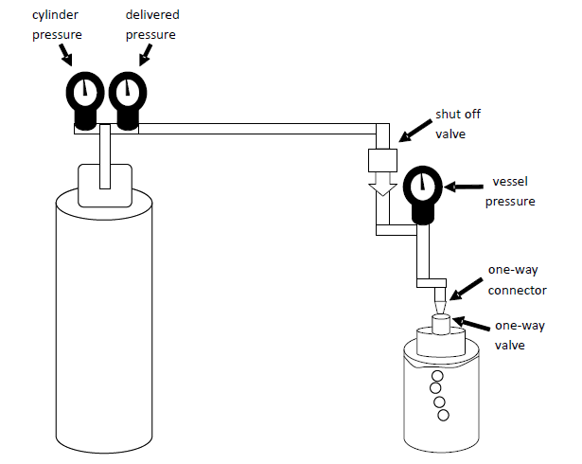
Method:
Sample Preparation
Brand | Temperature (⁰C) | Carbonation Level
Coca-Cola | 5 | Full
Coca-Cola | 20 | Full
Coca-Cola | 5 | Low
Coca-Cola | 20 | Low
Pepsi | 5 | Full
Pepsi | 20 | Full
Pepsi | 5 | Low
Pepsi | 20 | Low

Slide 6
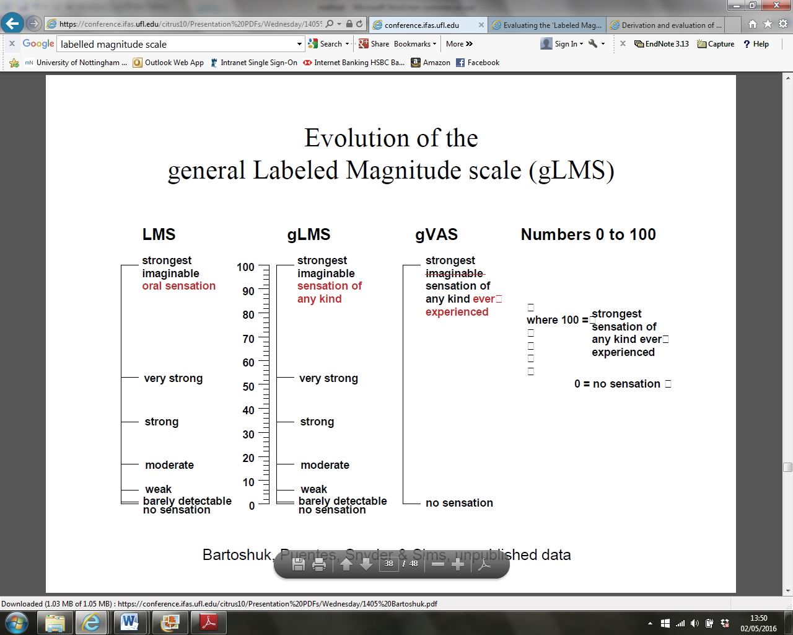
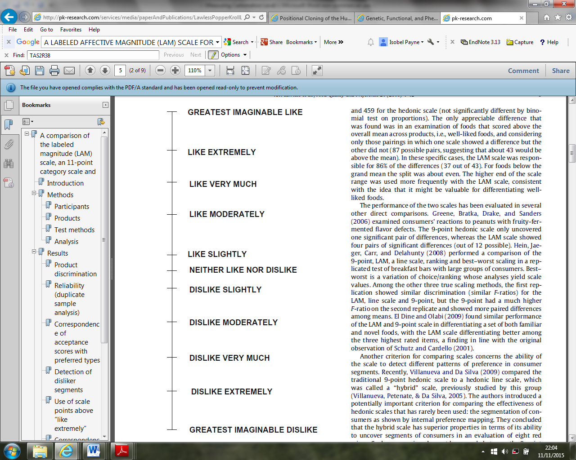
Method:
Panel Sessions
1) Acceptance
2) Perceived intensity of key attributes
(Sweet, Sour, Cola Flavour, Carbonation Level)
3) Ideal intensity of key attributes
(Sweet, Sour, Cola Flavour, Carbonation Level)
LAM Scale
gLMS

Slide 7
Statistical Analysis
Conducted ANOVA to investigate differences between thermal taster groups for:
  Acceptance ratings
  Perceived intensity ratings of attributes
  Ideal intensity ratings of attributes

Slide 8
Results: Acceptance
Fig. 1. Acceptance ratings for samples at 20⁰C and 5⁰C both TTs and TnTs.
Fig. 2. Comparing acceptance ratings for most accepted and least accepted samples for both TTs and TnTs.
TTs: most accepted = CF5, least accepted = PL20.
TnTs: most accepted = CL5, least accepted = CL20.
Bars represent mean acceptance rating, error bars show standard error. *Indicates a significant difference between TT and TnT at p<0.05. *** Indicates a significant difference between most and least accepted samples within the TTS group at p<0.001.
Notes:
Bars represent mean acceptance rating, error bars show standard error. *Indicates a significant difference between TT and TnT at p<0.05.
*** Indicates a significant difference between most and least accepted samples within the TTS group at p<0.001.

Slide 9
Results:
Perceived Intensity at 5⁰C
S
M
W
Fig. 3. Intensity perceived by TTs and TnTs for the four key attributes for samples at 5⁰C.
Bars represent log mean intensity, error bars show standard error. *Indicates a significant difference between TTs and TnTs for perceived intensity at p<0.05.
Notes:
Bars represent log mean intensity, error bars show standard error. *Indicates a significant difference between TTs and TnTs for perceived intensity at p<0.05. Secondary scale indicates labels on the gLMS: S=strong, M=moderate, W=weak.

Slide 10
Results:
Ideal Intensity
VS
S
M
W
Fig. 4. Ideal intensity rated by TTs and TnTs for the four key attributes for samples of Cola.
Bars represent log mean intensity, error bars show standard error. *Indicates a significant difference between TTs and TnTs for ideal intensity at p<0.05. ***Indicates a significant difference between TTs and TnTs for ideal intensity at p<0.001.
Notes:
Bars represent log mean intensity, error bars show standard error. *Indicates a significant difference between TTs and TnTs for ideal intensity at p<0.05. ***Indicates a significant difference between TTs and TnTs for ideal intensity at p<0.001.

Slide 11
Conclusions
TTs rated 5⁰C cola samples significantly more acceptable than TnTs.
TTs rated 5⁰C cola samples significantly lower for perceived sweetness than TnTs.
TTs rated ideal carbonation level significantly higher than TnTs.
TTs preferred cola at 5⁰C could be due to the decreased perception of sweetness and the higher carbonation levels.
Research contributes to the understanding of the variation between TTs and TnTs.
First study of its kind to use a commercially available carbonated soft drink.

Slide 12
References
Bajec, M. R. & Pickering, G. J. (2008) Thermal taste, PROP responsiveness, and perception of oral sensations. Physiology & Behavior, 95(4), 581-590.
Cruz, A. & Green, B. G. (2000) Thermal stimulation of taste. Nature, 403(6772), 889-892.
Green, B. G. & George, P. (2004) Thermal Taste Predicts Higher Responsiveness to Chemical Taste and Flavor. Chemical Senses, 29(7), 617-628.
Hort, J., Ford, R. Eldeghaidy, S. & Francis, S. (2016) - Thermal Taster Status: Evidence of Cross-Modal Integration, Human Brain Mapping., 1-12.
Schutz, H. G. & Cardello, A. V. (2001) A labeled affective magnitude (lam) scale for assessing food liking/disliking.

