Slide 1
Ecotrophelia Masterclass:
Guidance for Tutors

Slide 2
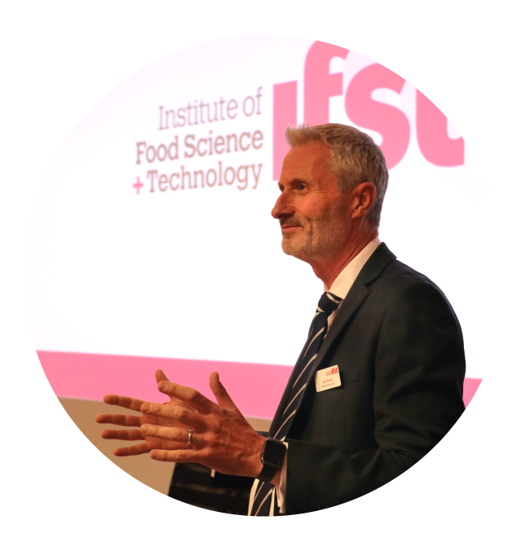
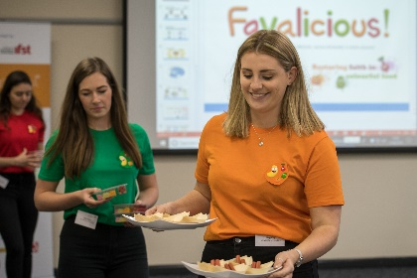
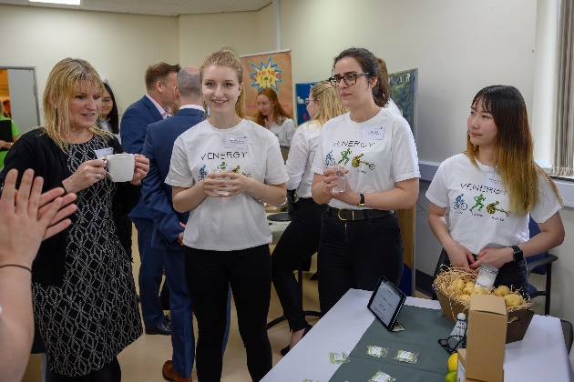
What is Ecotrophelia?
European-wide ‘dragons den’ style competition
UK finals organised jointly by IFST and Campden BRI
Students create a new eco-innovative product from developing the product idea, manufacturing processes, safety considerations, marketing etc.

Slide 3
What is Ecotrophelia?
Teams of students compile a portfolio of all the research and development of their product which is first assessed by preliminary judges
The teams with the top 5 products and portfolios progress through to the UK final and present to the ‘dragons’.
The Gold prize winning team goes on to represent the UK in the European finals.

Slide 4
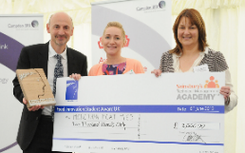
Abertay
CAFRE
Cambridge
Cardiff Met
Coventry
Harper Adams Leeds
Leeds Trinity
Liverpool
Liverpool Hope
London Met
London South Bank
Middlesex
Nottingham
Nottingham Trent
Reading
Royal Agriculture
Sheffield Hallam
West London
8th year
400+ students
19 Universities (added to curriculum)
Placement students
Industry sponsors

Slide 5
The ‘Dragons’
Prizes sponsored by:
Competition sponsored by:
Media Partner:

Slide 6
Previous Success
2020
2019
2018
2017
2016

Slide 7
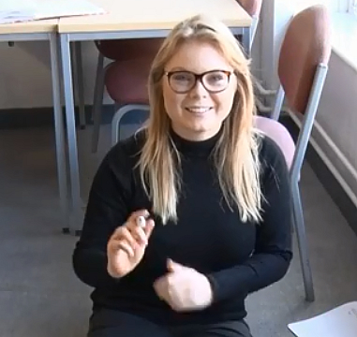
Previous Success
Charlotte Reynolds
2013 Winner with ‘ More Than Meat Pies’
Founder Of Blooming Foods Ltd
“The confidence and experience I gained from Ecotrophelia enabled me to create lupin crisp-like snacks, which I aptly named Blooming Food Lupin Bites. The lupin snacks won this global competition and saw me travel across the world showcasing a product that addresses issues such as a providing a convenient protein alternative for an ever growing population, utilising the functionality of an elusive pulse and celebrate the eco credentials of pulses and grain legumes.”

Slide 8
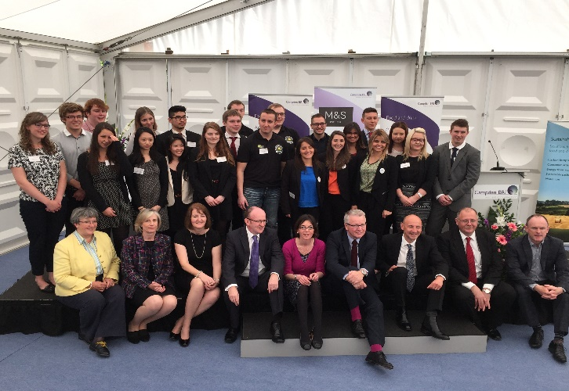
Why encourage students to take part?
Unique opportunity to experience NPD in the real world.
Cross curriculum skills
Hands on experience with each stage
Prizes!
University and business links
Assessed by industry leaders, not academics

Slide 9
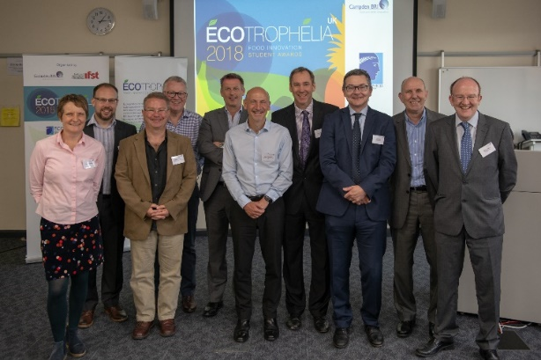
What makes a great portfolio/product?
Well presented compelling presentation - both written and oral
- Highlighting the innovation aspects and in particular the Eco- Innovation aspects - not just compostable packaging!
- Up to date and relevant legislation used eg claims
- HACCP, allergens and food safety aspects fully covered
- Realistic Business case/plan
- Good use of different marketing channels
- Great Product!

Slide 10
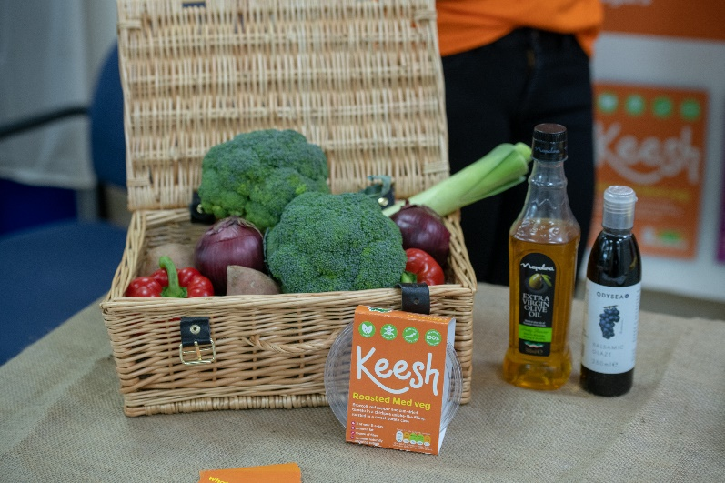
Ecotrophelia and the ‘new normal’
Virtual option
We all need to be flexible.
Encourage students to do as much of the portfolio work as possible before any lab time is required.

Slide 11
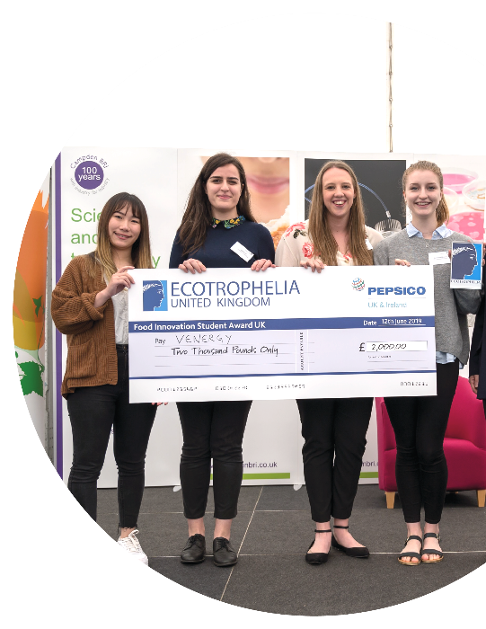
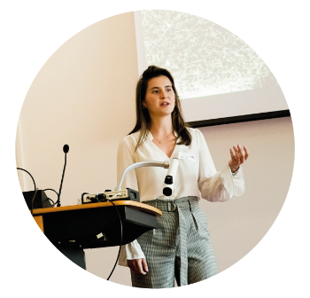
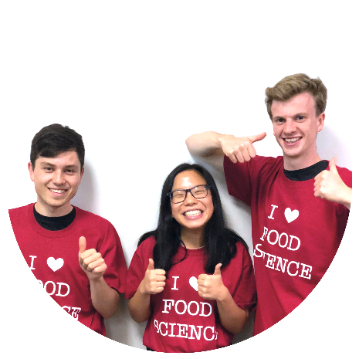
Dates and Deadlines
March 2021 - Application deadline, including full technical dossier
April 2021 - Shortlisted teams announced
June 2021 - Ecotrophelia UK competition final and prize giving
October 2021 - European final
NOTE: Projects/portfolios can be started and completed anytime before the deadline!
Notes:
An important part of IFST’s work is encouraging the next generation of food professionals. It is critical that we help ensure that there are sufficient young people entering the profession to assure the future of our food supply. We provide a range of exciting and highly stimulating events and competitions including the UK heat of the EU-wide Ecotrophelia undergraduate NPD competition.
Our Love Food Love Science website and resources are aimed at teachers and GCSE age groups.

Slide 12
Please also check our website for more information/resources:
www.ifst.org/ecotrophelia
and watch our prize winning teams present their products:
Notes:
An important part of IFST’s work is encouraging the next generation of food professionals. It is critical that we help ensure that there are sufficient young people entering the profession to assure the future of our food supply. We provide a range of exciting and highly stimulating events and competitions including the UK heat of the EU-wide Ecotrophelia undergraduate NPD competition.
Our Love Food Love Science website and resources are aimed at teachers and GCSE age groups.

Slide 13
Any Questions?
Contact: r.jones@ifst.org

